Slide 1

risk analytics in banking and financial service
Insights

Slide 2
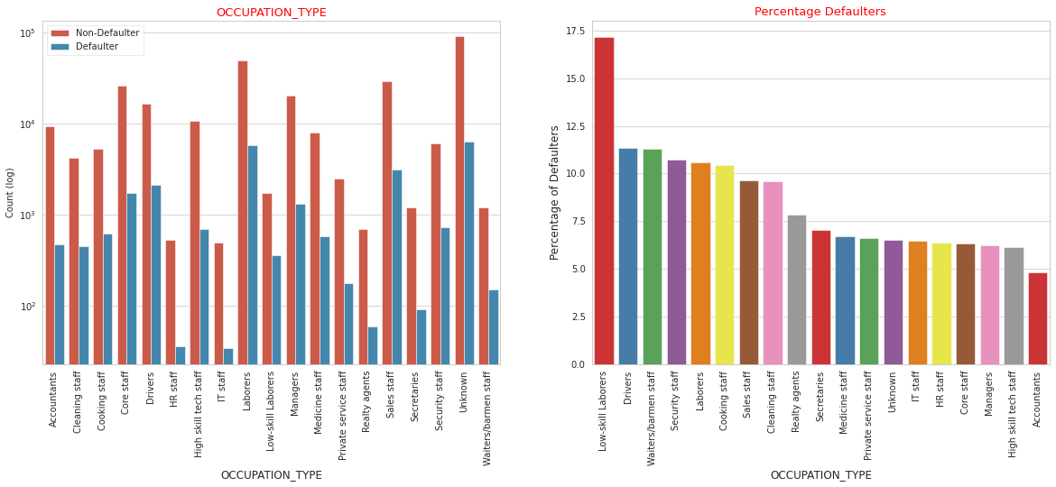
Univariate Analysis
Insights:
Laborers have taken most no. of loans followed by Sales staff, core staff, Managers.
Low-skill Laborers have defaulted most no. of loans(approx. 17%) followed by Waiters/Barmen staff, Drivers, Secondary staff.
For a very high number of applications occupation type information is unknown.

Slide 3
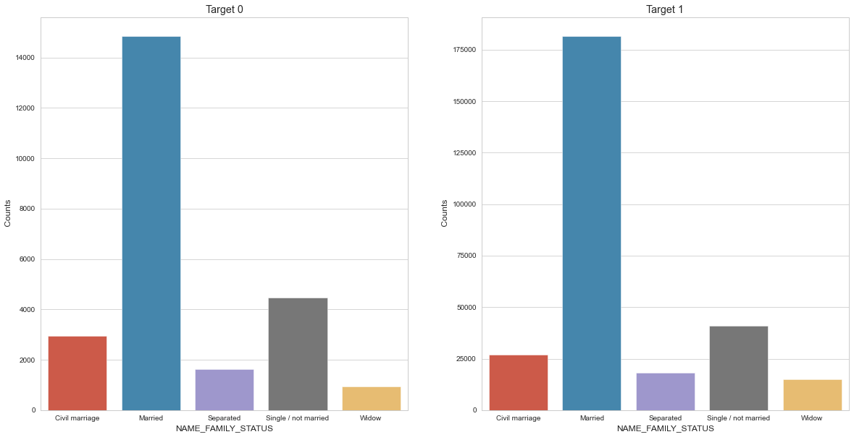

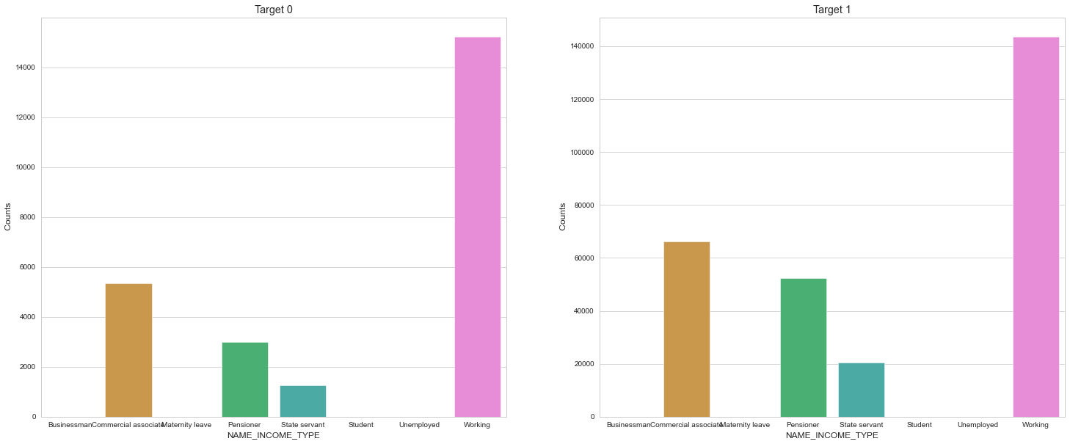
Insights:
Married people have taken most number of loans.
Civil Marriage folks and Single/Unmarried are the ones who defaulted on the most number of loans.
Widows have defualted on least number of loans
Target 0 – Non Defaulters Target 1 - Defaulters
Insights:
People who are working have highest number of loans.
Although females on maternity leaves have taken significantly lower number of loans but have approximately 40% default rate amongst them which is the highest in any category.
People who are unemployed have a default rate of more than 35%.

Slide 4
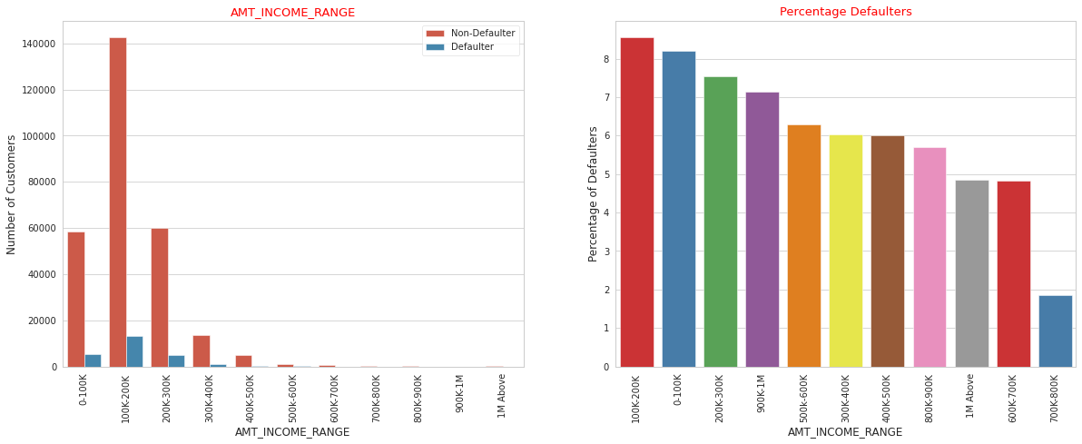
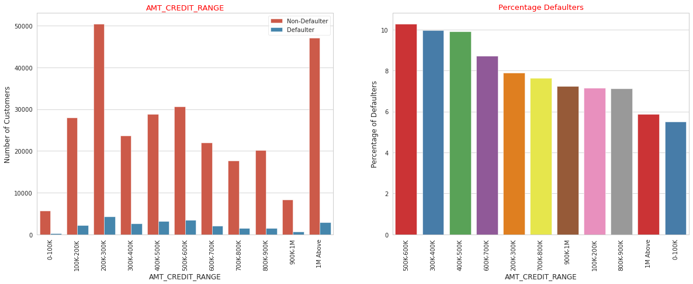

Insights:
Most of the applicants have income less than 300K.
Applicants with income more than 700K are less likely to default.
Applicants with income less than 300K are more likely to default.
All Credit Type Analysis:
Insights:
People with credit amount between 400K-600K tend to default more than others.

Slide 5
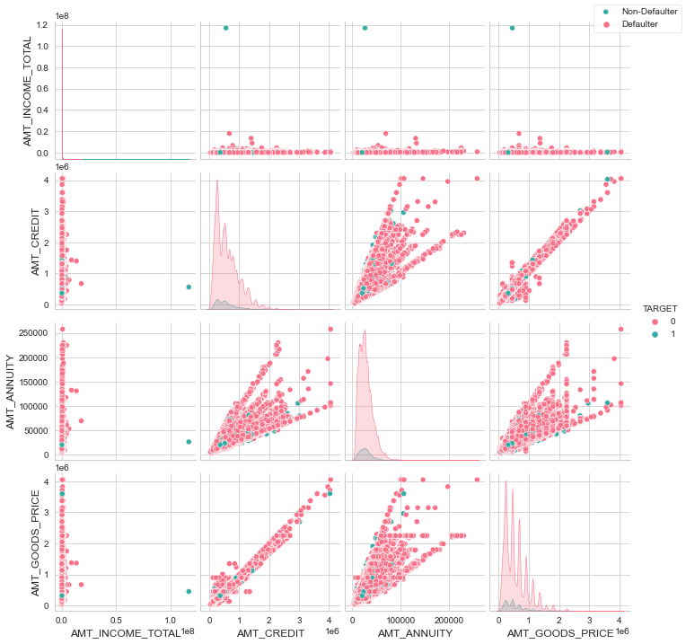
Numerical Univariate and Bivariate Analysis
INSIGHTS from individual Distribution plots
Most number of loans are given for goods price below 10 lakhs.
Most people pay annuity below 50000 for the credit loan.
Credit amount of the loan is mostly less then 10 lakhs.
The Non-Defaulter and defaulters distribution overlap in all the plots and hence we cannot use any of these variables in isolation to make a decision.
INSIGHTS from Scatter Plots
AMT_CREDIT and AMT_GOODS_PRICE are highly correlated, as the points are forming a straight line, thus showing a linear relationship between the two.
We can see that as AMT_CREDIT & AMT_GOODS_PRICE exceeds 3M, the proportion of defaulters decreases significantly.
When AMT_ANNUITY > 150K & AMT_CREDIT > 3M, the percentage of defaulters decreases.

Slide 6
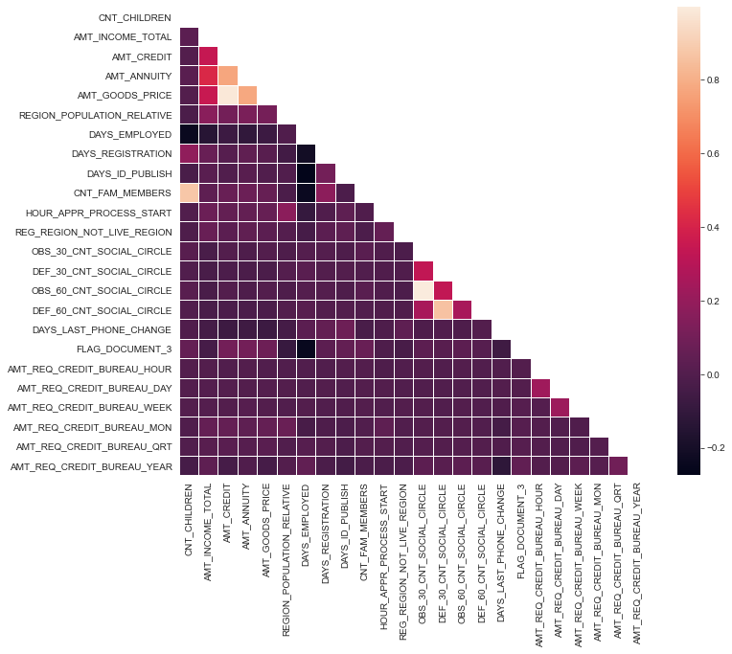
Correlation for Defaulters
Credit amount is inversely proportional to the date of birth, meaning Credit amount is higher for low age and vice-versa.
Credit amount is inversely proportional to the number of children client have, meaning Credit amount is higher for less children count client have and vice-versa.

Slide 7

Correlation for Non - Defaulters
Credit amount is highly correlated with amount of goods price which is same as Non-Defaulter
But the loan annuity correlation with credit amount has slightly reduced in defaulters when compared to Non Defaulters
We can also see that Non Defaulters have high correlation in number of days employed when compared to defaulters.

Slide 8
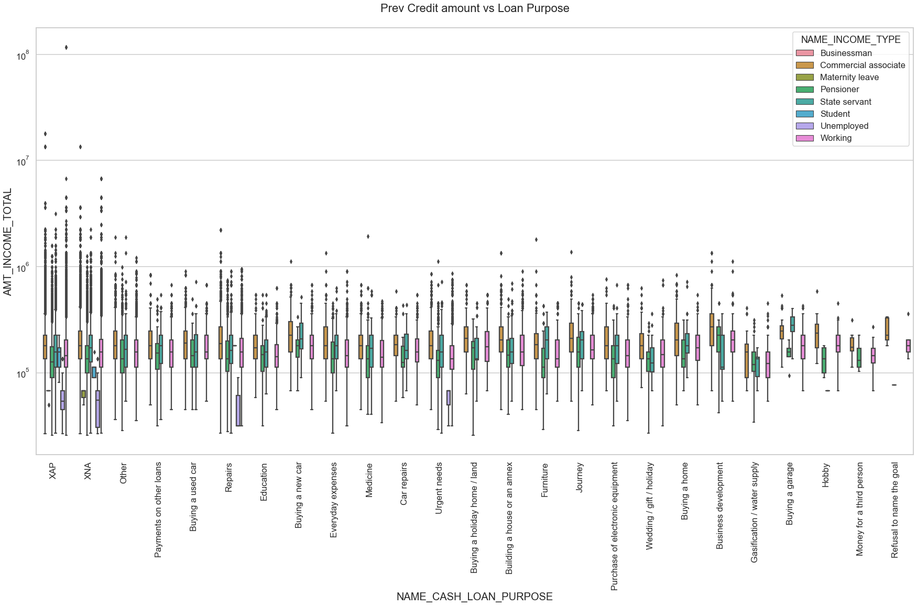

Slide 9
Insights:
Purpose of loan is unknown for very large number of applicants applying for the loan.
Banks have rejected high number of applications taken for Repair and Other purposes, also applicants have refused these offers more number of times.
There are few places where proportion of Non-Defaulters is higher.
Buying a garage
Business development
Buying land
Buying a new car
Education
Therefore we can focus on these purposes for which default percentage is less.

Slide 10

Conclusions
Factors which indicate that the person will be a Non-Defaulter are:
LOANS_EDUCATION_TYPE: Individuals who have Academic Degrees have less defaults as compared to other people.
NAME_INCOME_TYPE: Students and Businessmen have no defaulters.
NAME_FAMILY_STATUS: Widows are least likely to default on the loans.
AMT_INCOME_TOTAL: Customers who have income in the range of 700K and 800K are least likely to default.
ORGANIZATION_TYPE: Clients with Trade Type:4 & 6, Industry Type:12 Transport Type: 1 are least likely to default.

